Slide 1

LEAD SCORING CASE STUDY
BY TANIA DAS

Slide 2
DATASET AND PROBLEM STATEMENT
PROBLEM STATEMENT-There is a company named X Education which sells online courses to industry professionals. Though the company gets a lot of leads, its lead conversion rate is very poor. For example, if , say, they acquire 100 leads in a day, only about 30 of them are converted. To make this process more efficient, the company wishes to identify the most potential leads, also known as ‘Hot Leads'. If they successfully identify this set of leads, the lead conversion rate should go up as the sales team will now be focusing more on communicating with the potential leads rather than making calls to everyone. The company requires you to build a model wherein you need to assign a lead score to each of the leads such that the customers with higher lead score have a higher conversion chance and the customers with lower lead score have a lower conversion chance. The CEO, in particular, has given a ballpark of the target lead conversion rate to be around 80%.
DATASET:-You have been provided with a lead’s dataset from the past with around 9000 data points. The target variable, in this case, is the column ‘Converted’ which tells whether a past lead was converted or not wherein 1 means it was converted and 0 means it wasn’t converted. This dataset consists of various attributes such as Lead Source, Total Time Spent on Website, Total Visits, Last Activity, Prospect ID, Lead Number ,Lead Origin ,Do Not Email, Do Not Call ,Page Views Per Visit ,Last Activity ,Country ,Specialization ,How did you hear about X Education ,What is your current occupation ,What matters most to you in choosing this course ,Search ,Magazine, Newspaper Article ,X Education Forums ,Newspaper ,Digital Advertisement ,Through Recommendations, Receive More Updates About Our Courses, Tags ,Lead Quality ,Update me on Supply Chain Content ,Get updates on DM Content ,Lead Profile ,City ,Asymmetric Activity Index ,Asymmetric Profile Index ,Asymmetric Activity Score ,Asymmetric Profile Score ,I agree to pay the amount through cheque, a free copy of Mastering the Interview ,Last Notable Activity.

Slide 3
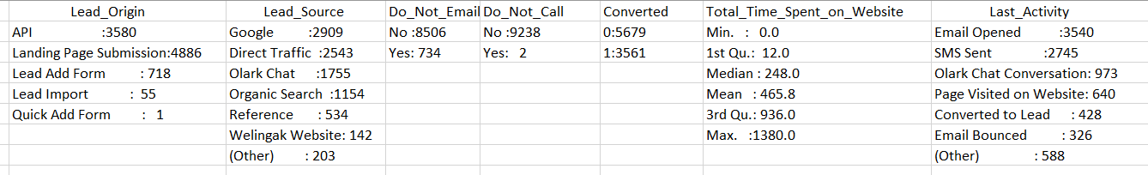
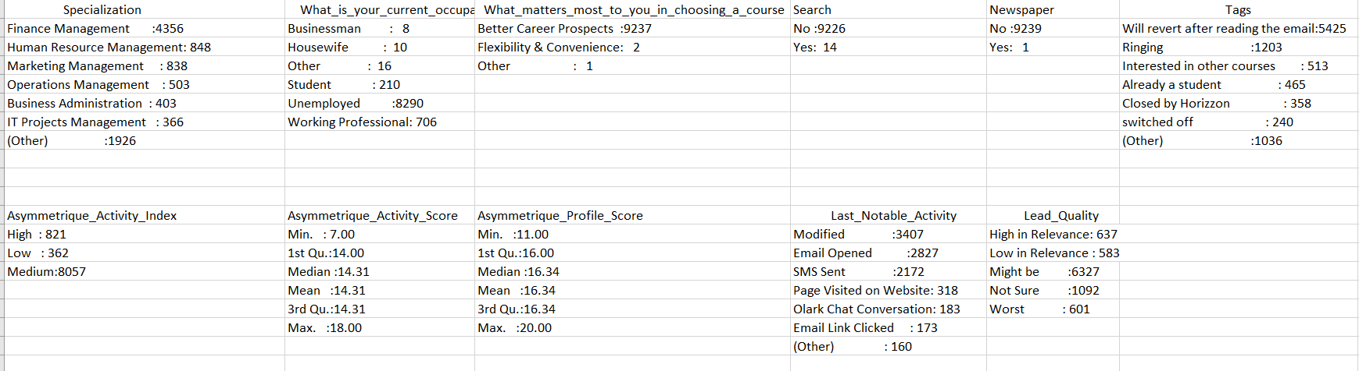
DATA EXPLORATION
SUMMARY OF ALL THE VARIABLES

Slide 4
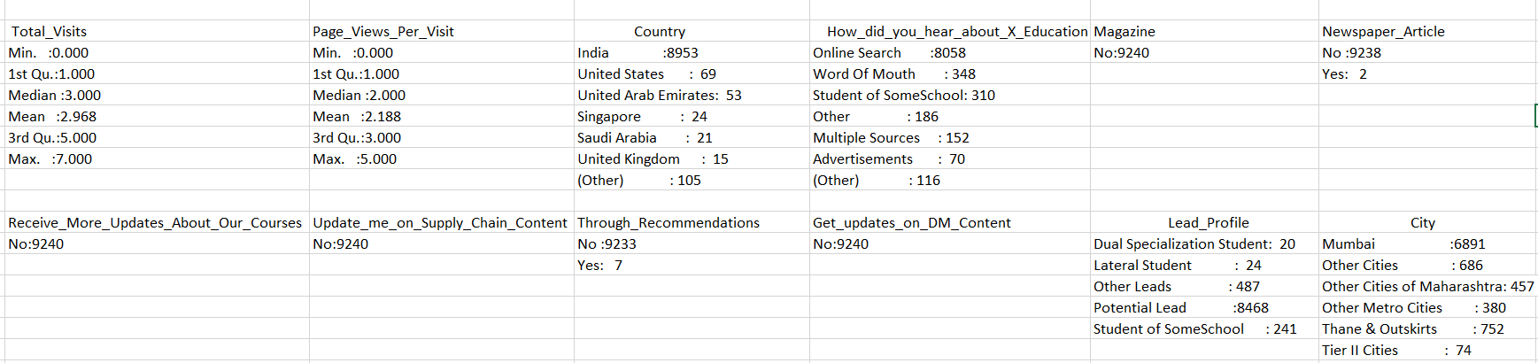
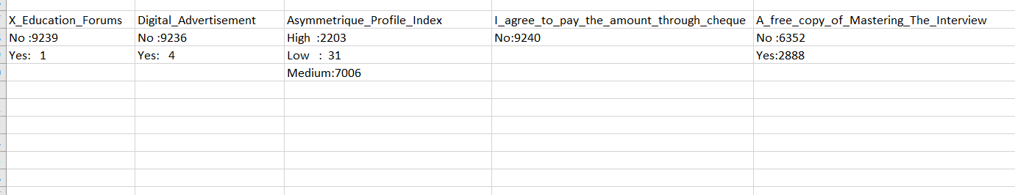
DATA EXPLORATION
SUMMARY OF ALL THE VARIABLES

Slide 5
DATA MANIPULATION
Total Number of Columns =37, Total Number of Rows =9240
Changed the column names of few of the columns. Replace the column names having spaces with an underscore.
Removing the “Prospect ID” and “Lead Number” which is not necessary for the analysis as both are unique identifier.
There were columns which had blank cells. We will replaced it with NA
There were quite a few columns which has 'Select' as one of the category. This is most probably because the person has not filled that field. We replaced it with NA.
Converted all the categorical variable with character data types as well as the dependent variable i.e Converted into factor variable.
The Lead_Source variable has two items “Google” and “google”. Since both the items are same that’s why replaced “google” with “Google”.
Treated the missing values. In case of factor variable, filled the missing values with the mode of the variable and in case of numerical variable filled with the median of the variable because the data was skewed.
Treated the outliers for “Total_Visits”, ”Total_Time_Spent_On_Website”, ”Page_Views_Per_Visit” with the help of capping method. In this technique, we cap our outliers data and make the limit i.e, above a particular value, all the values will be considered as outliers, and the number of outliers in the dataset gives that capping number. We have taken the limit as 90% quantile.There are other methods of outliers treatment like
Z-score : variables recalculated as (V - mean of V)/s, where "s" is the standard deviation. As a result, all variables in the data set have equal means (0) and standard deviations (1) but different ranges.
The interquartile range is calculated in much the same way as the range. All you do to find it is subtract the first quartile from the third quartile:IQR = Q3 – Q1.The interquartile range shows how the data is spread about the median

Slide 6
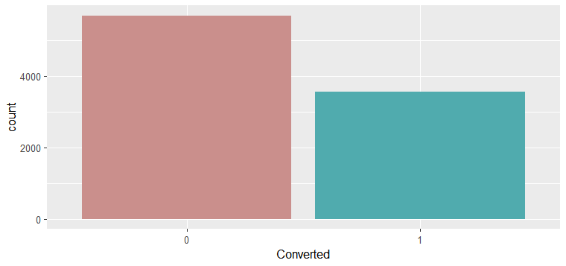
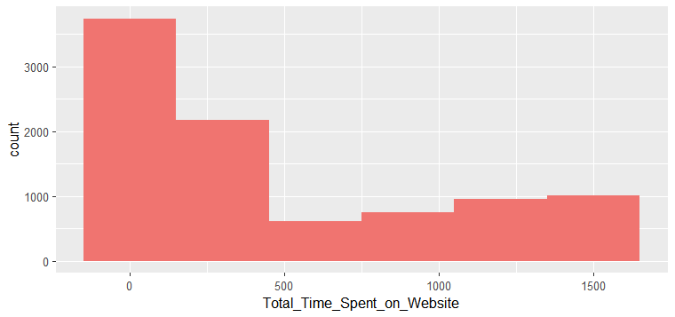
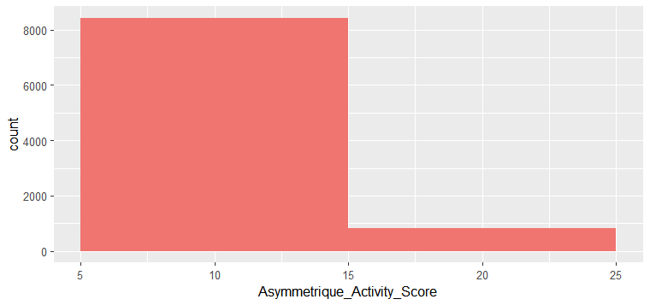
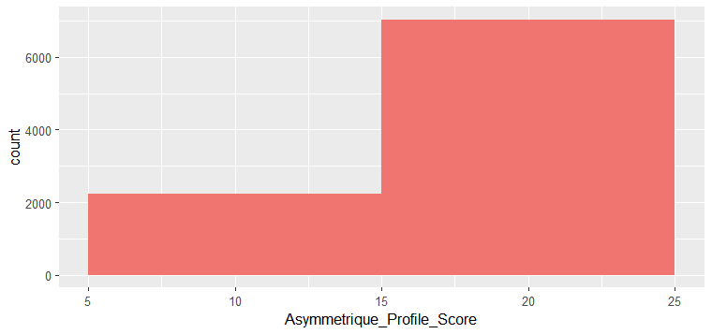
VISUALIZATION

Slide 7
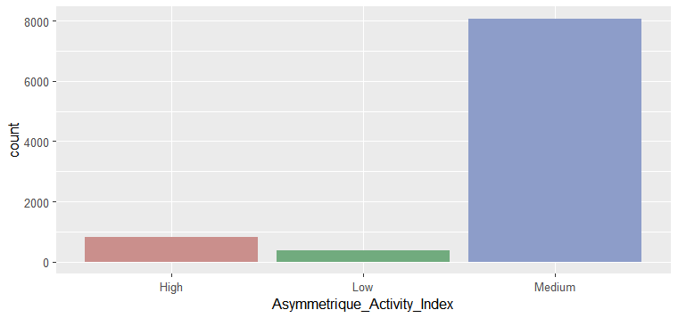
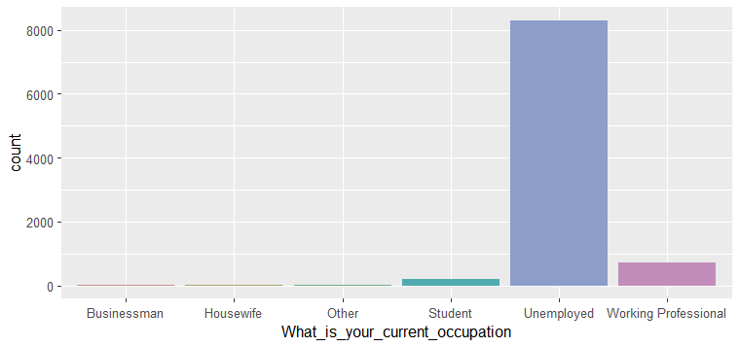
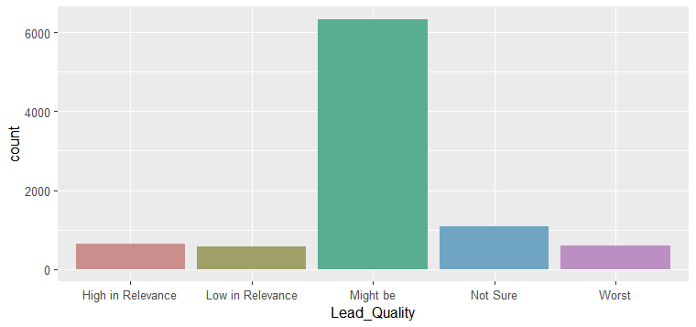
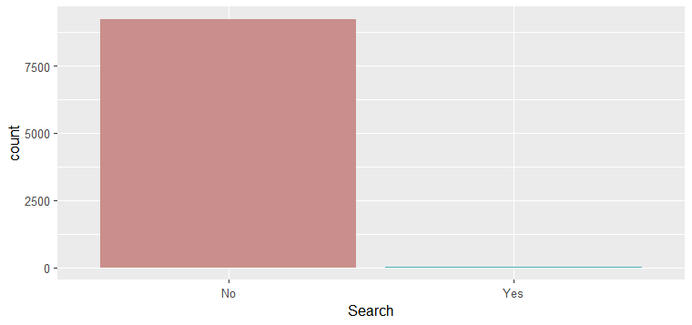
VISUALIZATION

Slide 8
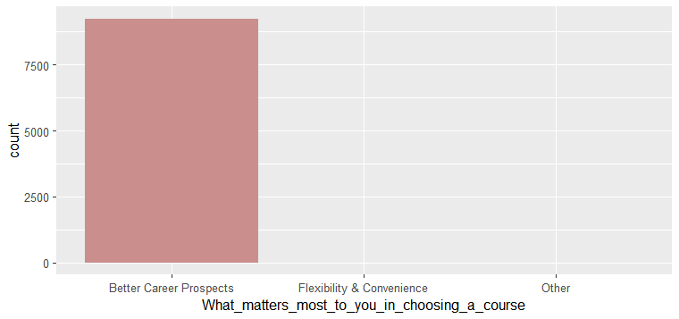
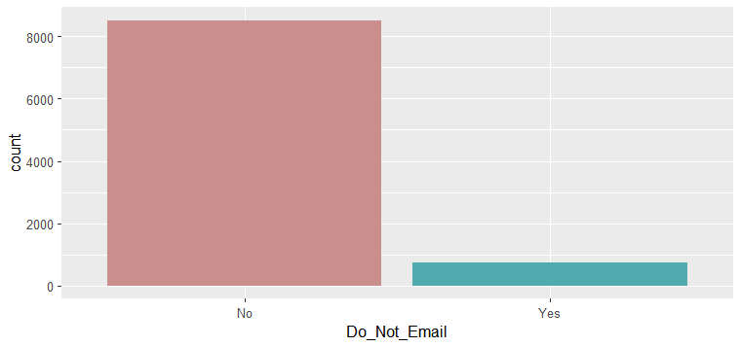
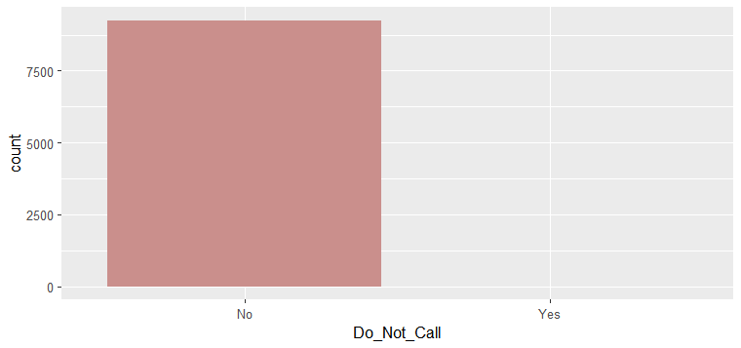

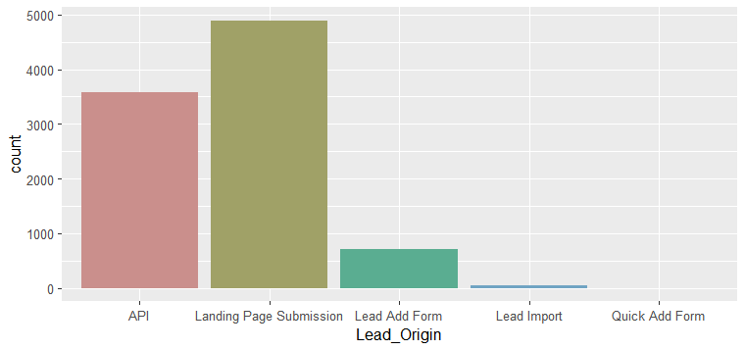
VISUALIZATION

Slide 9
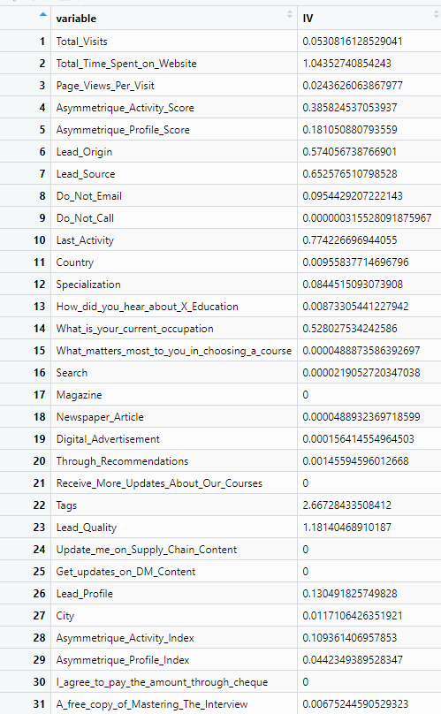

DATA EXPLORATION
INFORMATION VALUE OF ALL THE VARIABLES
According to Siddiqi (2006), by convention the values of the IV statistic can be interpreted as follows.
If the IV statistic is:
Less than 0.02, then the predicter is not useful for modeling (separating the Goods from the Bads)
0.02 to 0.1, then the predictor has only a weak relationship to the Goods/Bads odds ratio
0.1 to 0.3, then the predictor has a medium strength relationship to the Goods/Bads odds ratio
0.3 or higher, then the predictor has a strong relationship to the Goods/Bads odds ratio.
I have dropped variables which has IV less than 0.02 and 0.02 to 0.1.From the main data I have dropped Total_Visists,Page_Views_Per_Visit,Country,City,How_Did_You_Hear_About_X_Education,Magazinne,Digital_Advertisemnet,Through_Recommendations, Receive_More_Updates_About_Our_Courses, Update_me_on_Supply_Chain_ Content, Get_updates_on_DM_Content,Lead_Profile, Asymmetrique_Profile_Index, I_agree_to_pay_the_amount_through_cheque, A_free_copy_of_Mastering_The_Interview .After removing all this variable the dataset had 20 variables in it to work with.

Slide 10
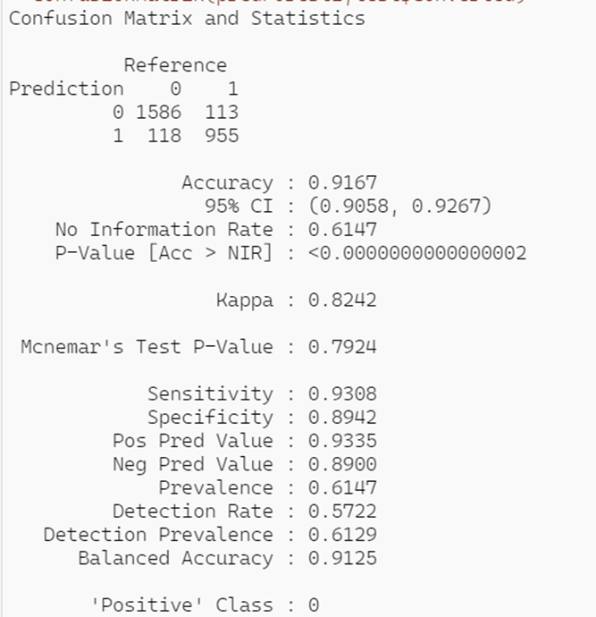
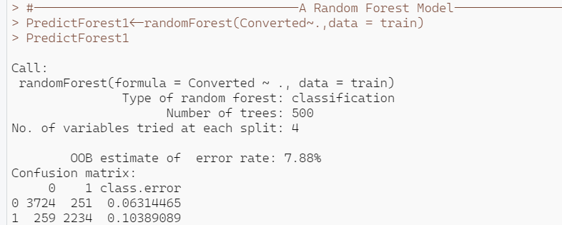
BUILDING THE MODEL
SPLITTING THE DATASET INTO TRAIN AND TEST DATASET
The entire dataset is split into train and test dataset in the ratio of 70:30.After splitting the dataset we noticed that the train dataset has two variables Newspaper_Article and X_Education Forums which has one factor level. We dropped those variable from the dataset since there isn’t any variation at all in those predictor variable. It is necessary to drop it otherwise R wont be able to run the model. After dropping the two variables the final dataset is left with 18 variables. Again the entire dataset was splitted in the ratio of 70:30.
RANDOM FOREST
Next we applied Random Forest on the train dataset. The outcome which we derived is
My accuracy is approximately 91%,which is quite high. Thereby we can conclude that our model is good

Slide 11
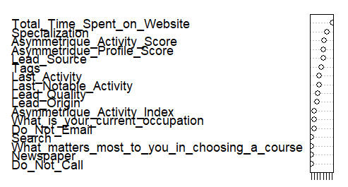
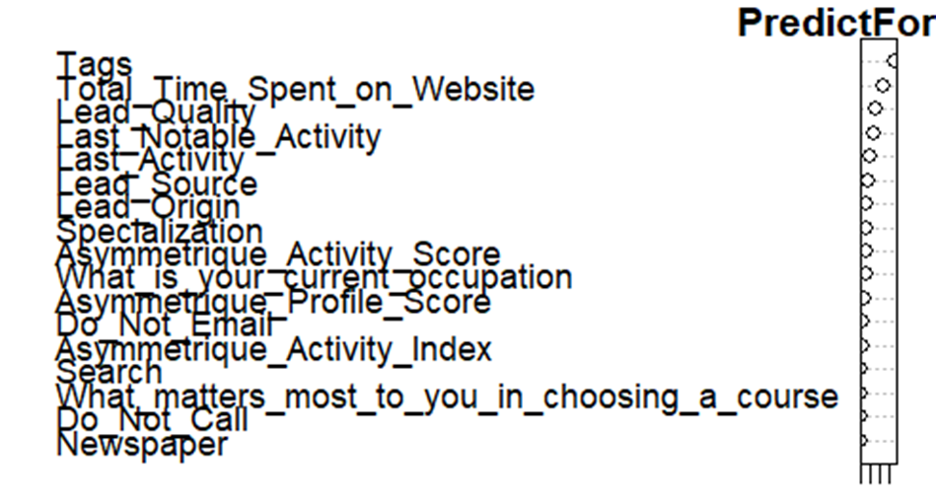
VARIABLE IMPORTANCE CHART AND MEASURING IMPURITY IN RANDOM FOREST
Here, ‘Total_Time_Spent_on_Website' variable is most important in terms of number of splits each variable measures the number of times that variable was selected for splitting (the value on the x-axis)
A different metric we can look at is related to "impurity", which measures how homogenous each bucket or leaf of the tree is. In each tree in the forest, whenever we select a variable and perform a split, the impurity is decreased.
Therefore, one way to measure the importance of a variable is to average the reduction in impurity,
taken over all the times that variable is selected for splitting in all of the trees in the forest. Here, ‘Tags' variable is most important in terms of mean reduction in impurity.

Slide 12
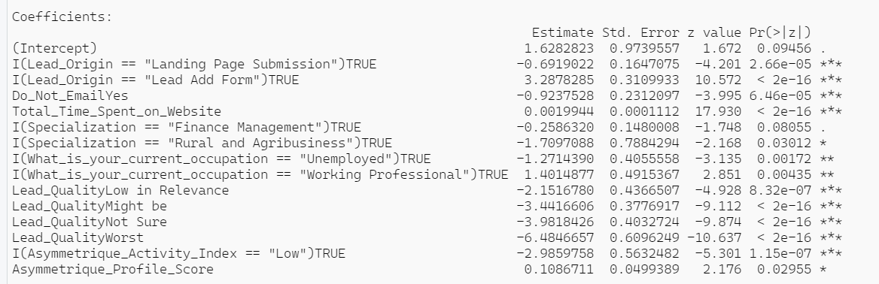
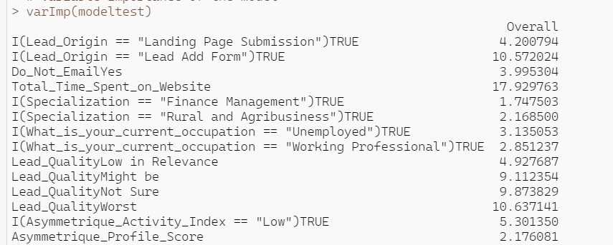
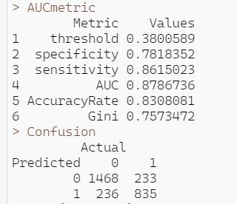
BUILDING THE MODEL
LOGISTIC REGRESSION MODEL
In order to build the training model
we removed the insignificant variables one by one on the basis of high p-value and vif.Finally after removing the insignificant variables and after validating the training model on test data we were left with 15 significant variables.
True negative: 1468
False negative: 233
True Positive: 835
False positive: 236
AUC should be > 0.80 and the desirable range of Gini is 0.4-0.8 which is significant here.
Total_Time_Spent_on_Website is the variable with highest overall importance 17.929763

Slide 13
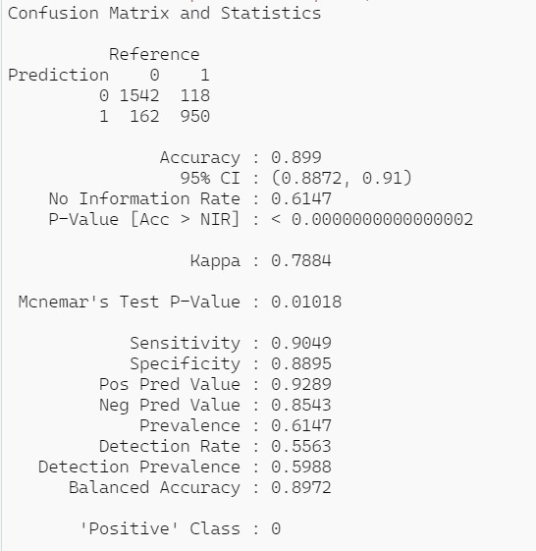
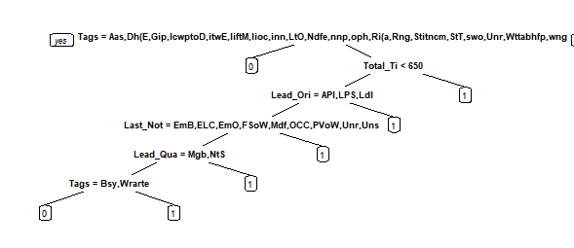
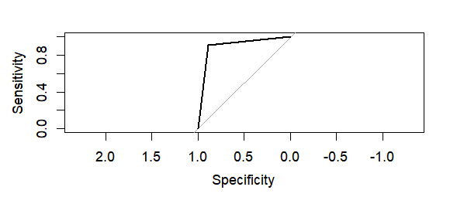
BUILDING THE MODEL
DECISION TREE
The tree which we achieved by running the model is shown in the figure
The roc-curve of the decision tree model is:
True negative: 1542
False negative: 118
True Positive: 950
False positive: 162
Accuracy of the model is approximately 89%
Area under the curve: 0.8972

Slide 14
WHY RANDOM FOREST AND NOT DECISION TREE OR LOGISTIC REGRESSION ON THIS DATASET
After obtaining the results of the different machine learning algorithms, I found random forest to be the most suitable one because:
Logistic Regression model displayed a accuracy rate of 83% and Decision Tree model displayed a accuracy rate of 89%,whereas accuracy rate of random forest is approximately 91% which is higher than logistic as well as decision tree model.
Moreover, by analyzing the other ROC curves, I revealed that the random forest did have the best performance by obtaining an area under the curve of 91% i.e. we can say that it has the best performance by detecting the different classes of the dependent variable better than the logistic regression and decision tree since they both acquired area under curve of approximately 87%, approximately 89% respectively.

Slide 15
CONCLUSION
It was found from the random forest model that the variables that mattered the most in the potential buyers are (In descending order) :
Total_Time_Spent_On_Website
Specialization
Asymmetrique_Profile_Score
Lead_Source
Tags
Last_Activity
Last_Notable_Activity
Lead_Quality
Lead_Origin
Asymmetrique_Activity_Index
What_is_your_current_occupation
Do_Not_Email
Search
What_matters_most_to_you_in_choosing_a_course
Newspaper
Do_Not_Call
Keeping these in mind the X Education can flourish as they have a very high chance to get almost all the potential buyers to change their mind and buy their courses.

